Slide 1
Writing for Your Audience
Emails and Memos

Slide 2
Parts to a Message
Salutation
Statement of issue
Requested action
Closing

Slide 3
Salutation
Used to greet your reader and set the tone
“Good morning”
Dear Steve,

Slide 4
Statement of Issue
Gets to the point of why you sent the email or memo
There’s a leak in the bathroom

Slide 5
Requested Action
Tells the reader what they should or can do
Please repair it if you can.

Slide 6
Closing
Wraps up the message politely
Good afternoon!
Sincerely, Maegan
Thank you!

Slide 7
Your Audience is Important
Right impression
Understand your points
Take you seriously

Slide 8
Different Audiences
Style
Structure
Word choice
Type of communication
Friends
Family
Coworkers
Supervisors
General

Slide 9
Coworker/Classmate
Friendly
Direct
Not too personal

Slide 10
Hello! Did you get the note I left on your desk? I thought you might want to talk to Steve. Anyway, don’t forget to bring the file on the Johnson case to the meeting tomorrow. --Sarah

Slide 11
Supervisor/Instructor
Formal
Detailed
Impersonal
Doesn’t make assumptions

Slide 12
Good Afternoon, I hope you received the message I left for you yesterday regarding the office prank that Steve played. I wanted to explain what occurred so that you could address it. Additionally, please remember to bring the finance file on the Johnson’s divorce case with you to our meeting with the lawyer tomorrow. Thank you! --Sarah Garrett

Slide 13
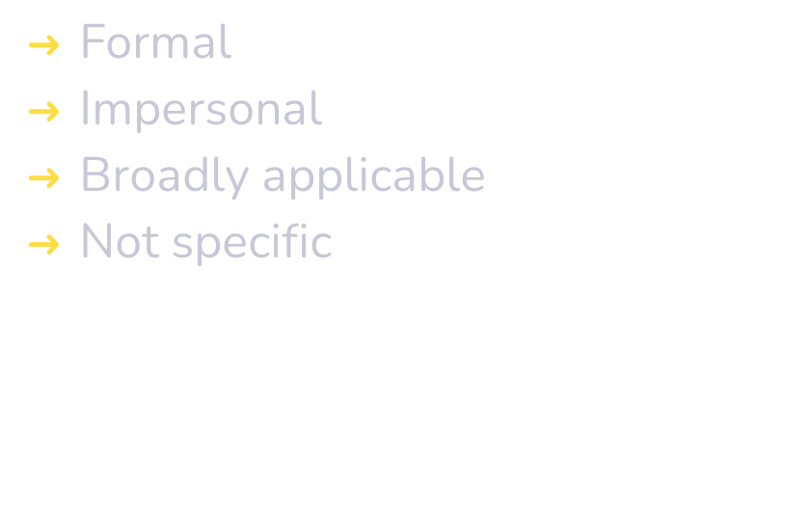
General Audience

Slide 14
Workplace jokes and pranks can sometimes distract from productivity and should be discouraged.

Slide 15
Family and Close Friends
Personal
Makes assumptions
Less/more details
Slang, shared language

Slide 16
Juanita! Oh my gosh. Steven did the craziest thing yesterday. He glued all of Martin’s office supplies to his desk. I gotta tell Lisa. She’s going to freak out. I’ll talk more about it later when we’re done with the Johnson’s case.

Slide 17

Texting
Abbrevations, emojis or other texting conventions are not usually acceptable for professional communication.
Hey!
G2G to the store
Want somethin?

Slide 18
Additional Suggestions
Have a relevant subject line–but don’t type your whole message in the subject
Use a signature that contains information about who you are:
Include a salutation and a closing, especially when contacting someone you don’t know

Slide 19
Let’s Practice!
Supervisor/instructor
Asking a question about an assignment
Greeting, statement of issue, requested action, closing

Slide 20
Summary
Include all parts of a message
Be aware of who you are writing to and how that should shape your language
Avoid text-speak in formal communication
Make sure to use your subject line properly

